Slide 1
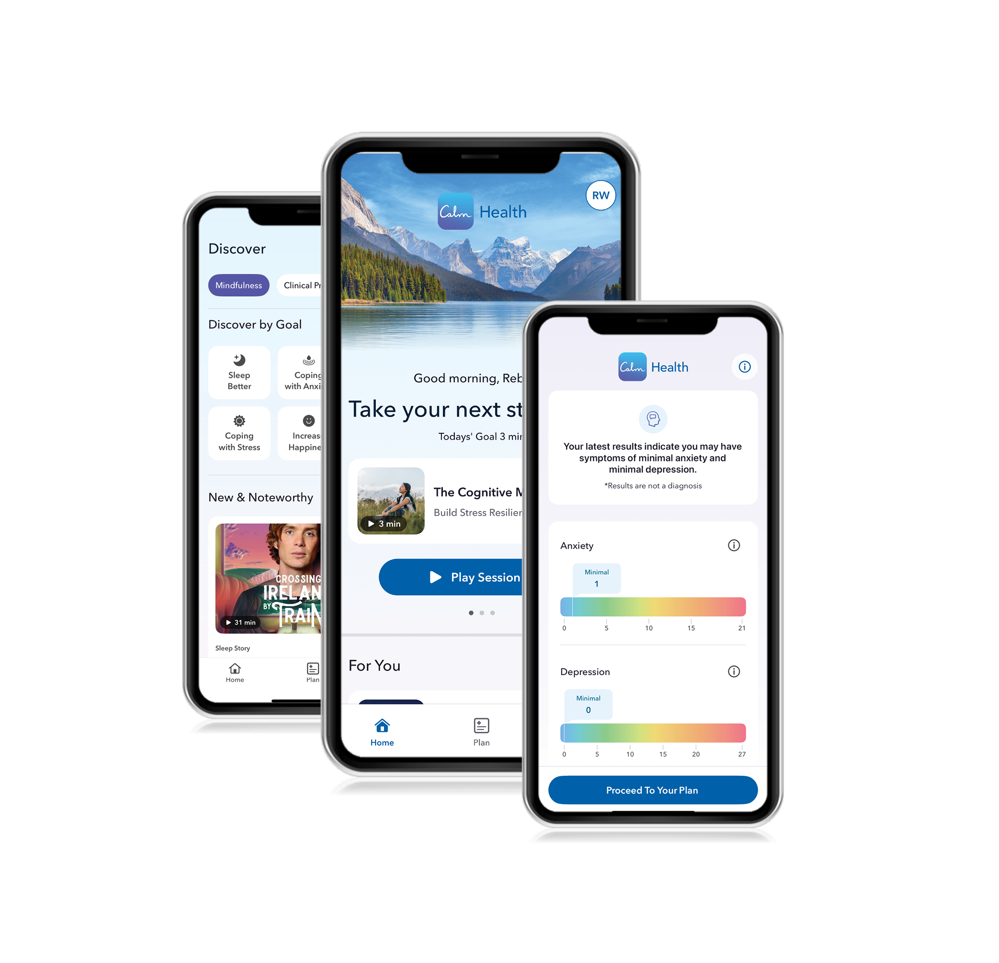

Calm Health registration guide
Ready to prioritize your mental and physical health?
Let Calm Health be your guide to better wellbeing.
Available through your benefits at no cost to you, Calm Health is an easy-to-use app with evidence-based programs to support your mental and physical health. It’s packed with content written by psychologists to help you sleep better, build skills to manage stress, practice mindfulness, improve focus and so much more.

Slide 2
First time accessing Calm Health?
Start here:
Visit supportfinder.optum.com/western
Sign in with a Support Finder username
Select the Calm Health spotlight tile, linking to the Calm Health registration page
  If using a laptop, you’ll go to the Calm Health web landing page
  If using a mobile device, you’ll go to the app store to download and open the Calm Health app
Follow the Calm Health registration steps:
  Select your preferred registration process (Sign up with Google, Apple, Facebook or email)
  Enter your phone number to set up multi-factor authentication
  Enter your first and last name and agree to the Calm Health terms of service and privacy policy
  Accept the Optum Spouse and Dependent Authorization
  Select your country of residence
  Enter your date of birth and gender
  Registration is now complete

